Slide 1
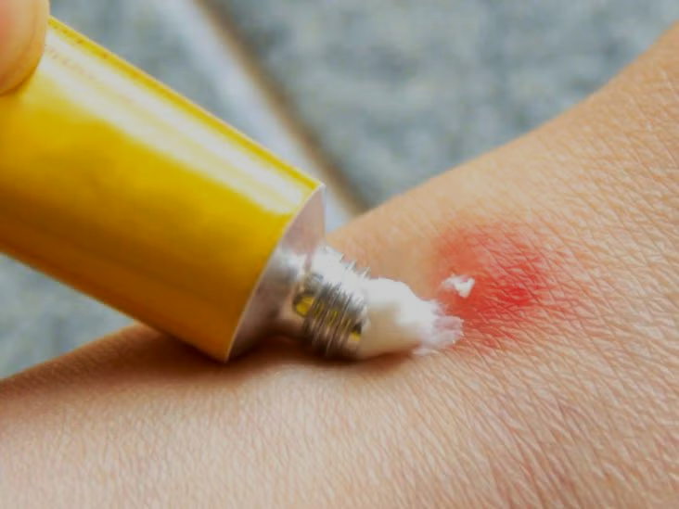
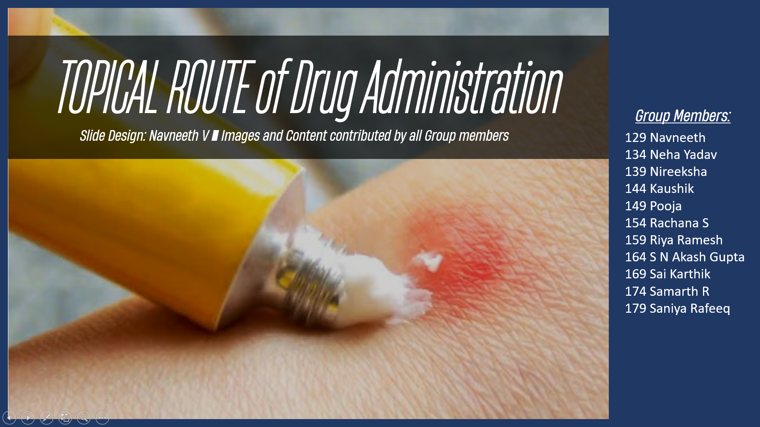
TOPICAL ROUTE of Drug Administration
Group Members:
Slide Design: Navneeth V ■ Images and Content contributed by all Group members
129 Navneeth
134 Neha Yadav
139 Nireeksha
144 Kaushik
149 Pooja
154 Rachana S
159 Riya Ramesh
164 S N Akash Gupta
169 Sai Karthik
174 Samarth R
179 Saniya Rafeeq

Slide 2
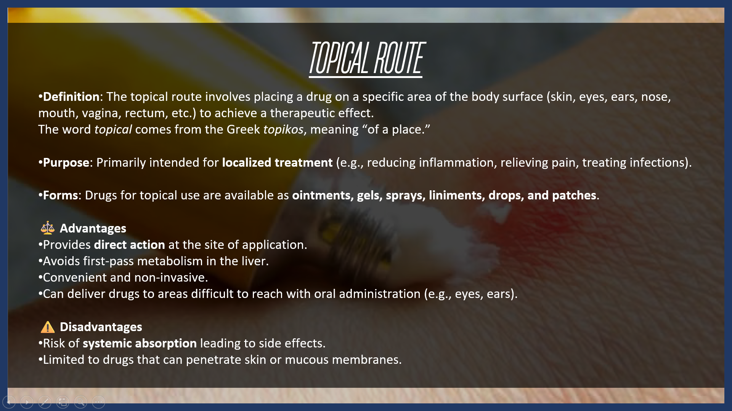
TOPICAL ROUTE
Definition: The topical route involves placing a drug on a specific area of the body surface (skin, eyes, ears, nose, mouth, vagina, rectum, etc.) to achieve a therapeutic effect. The word topical comes from the Greek topikos, meaning “of a place.”
Purpose: Primarily intended for localized treatment (e.g., reducing inflammation, relieving pain, treating infections).
Forms: Drugs for topical use are available as ointments, gels, sprays, liniments, drops, and patches.
⚖️ Advantages
Provides direct action at the site of application.
Avoids first-pass metabolism in the liver.
Convenient and non-invasive.
Can deliver drugs to areas difficult to reach with oral administration (e.g., eyes, ears).
⚠️ Disadvantages
Risk of systemic absorption leading to side effects.
Limited to drugs that can penetrate skin or mucous membranes.

Slide 3
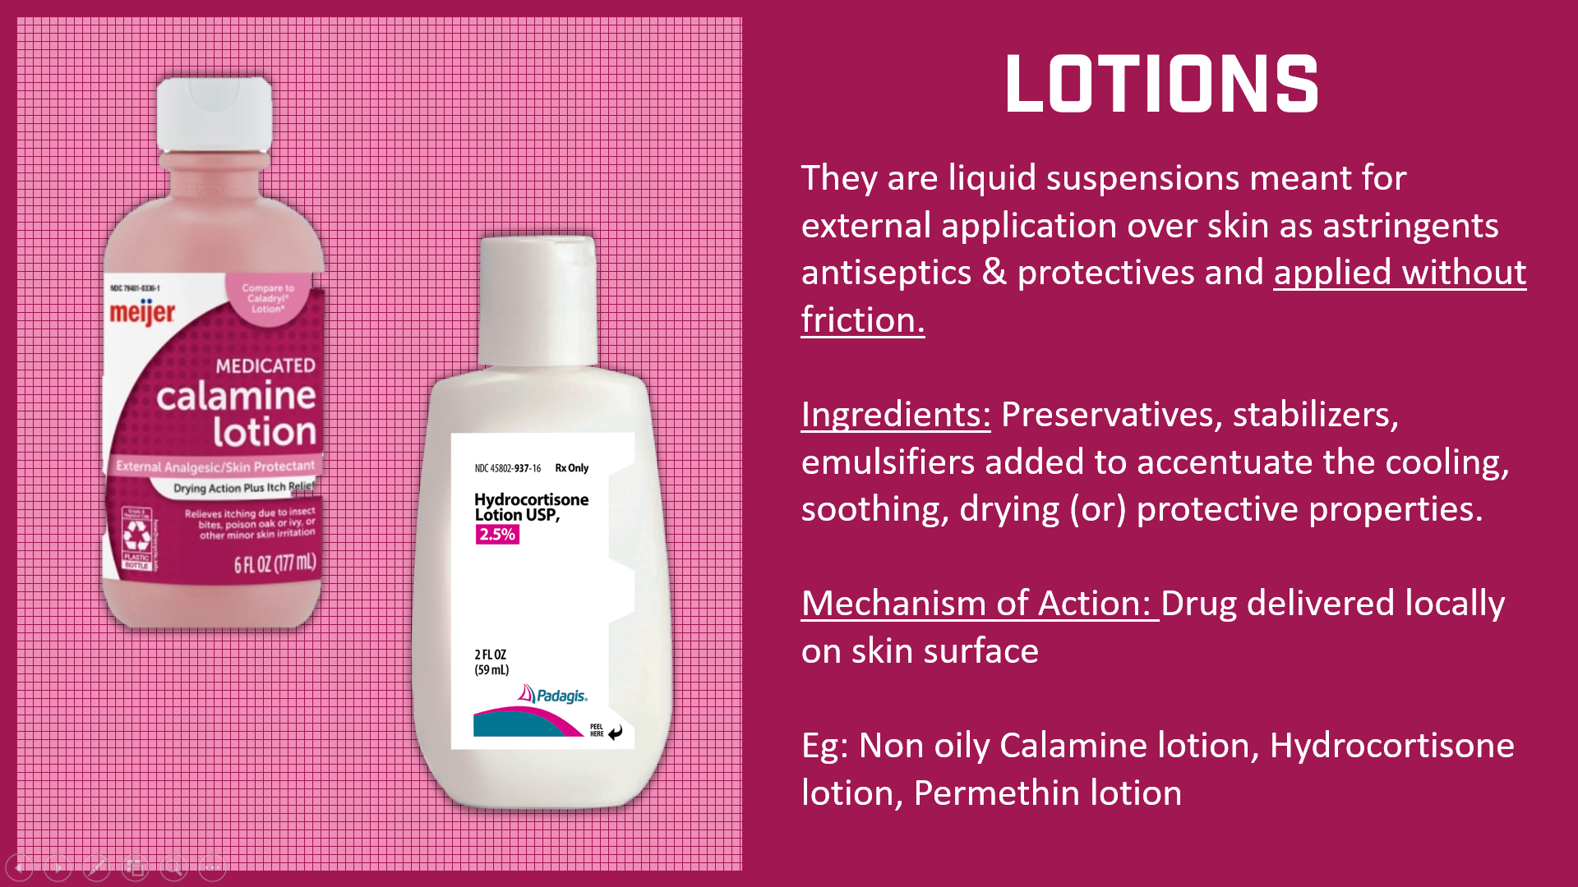
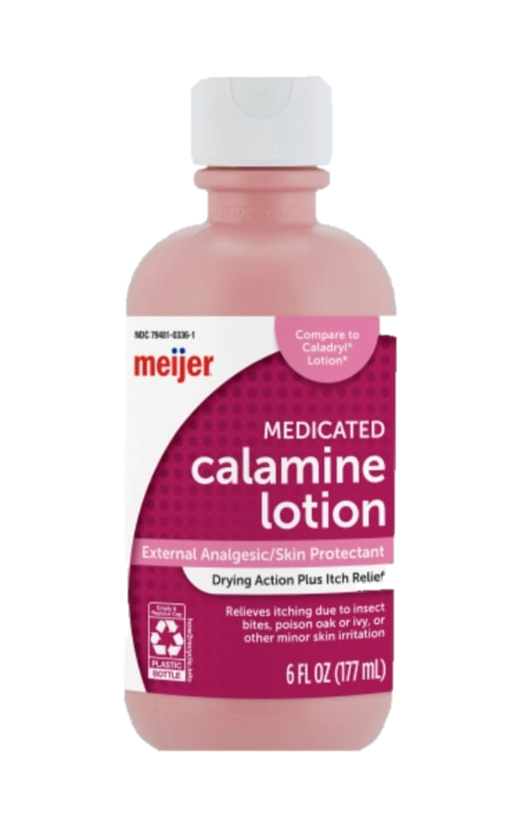
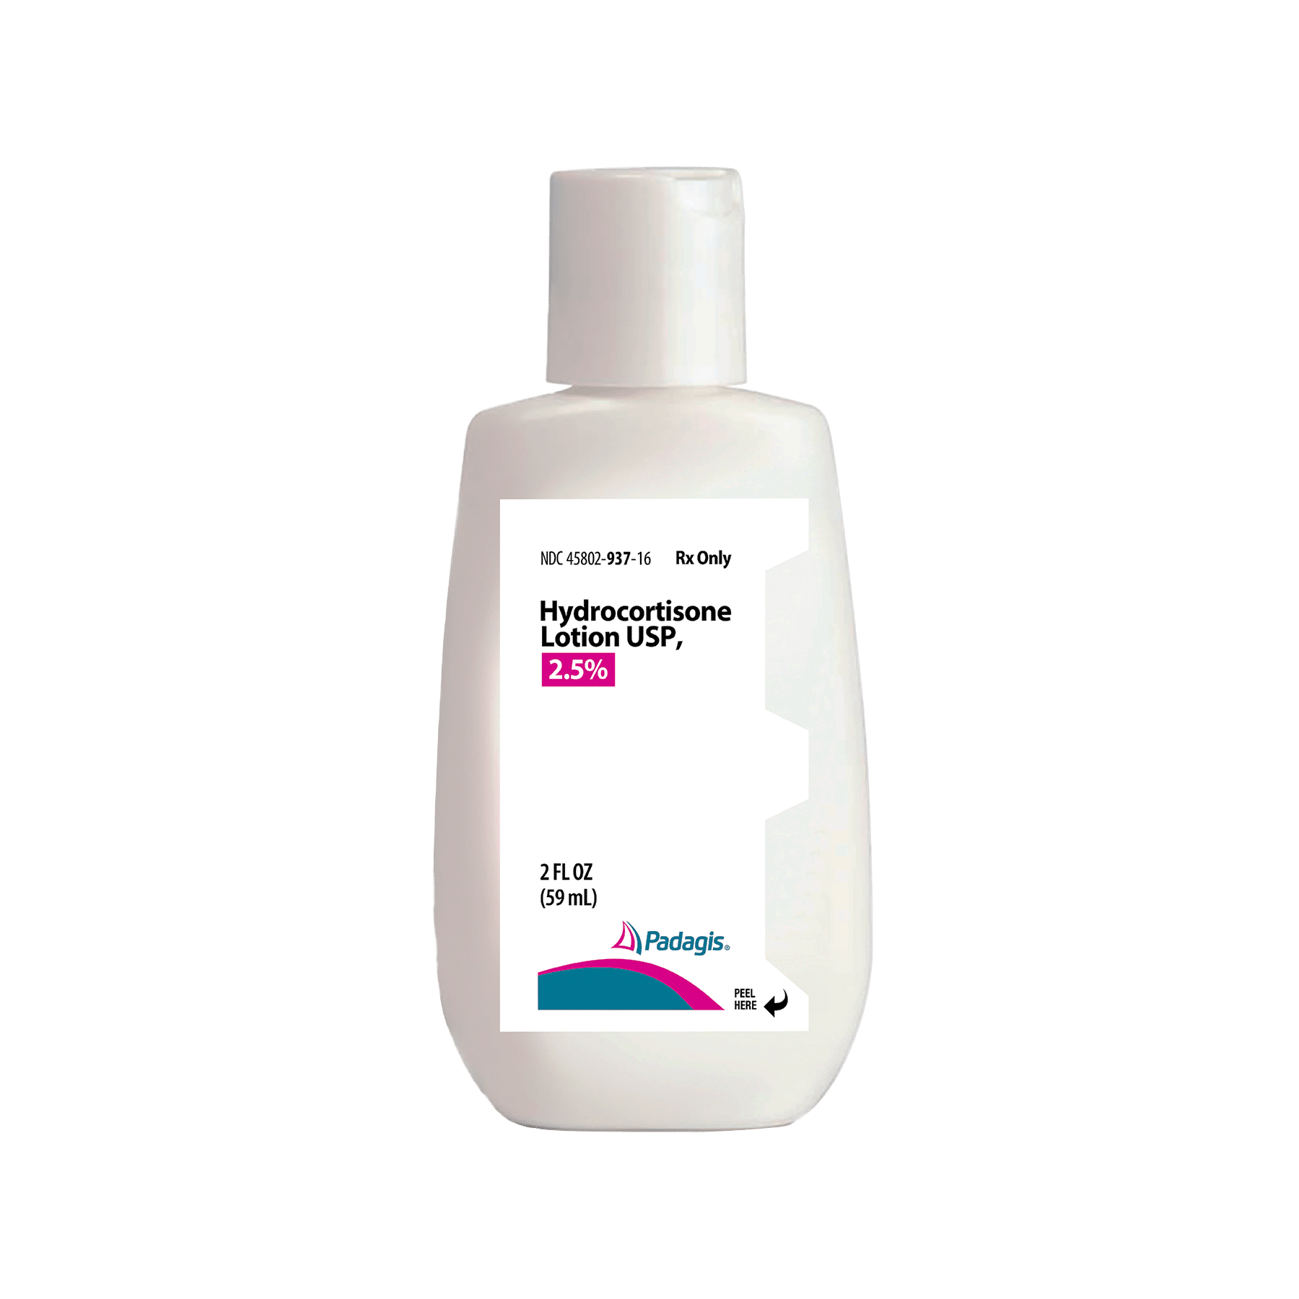
LOTIONS
They are liquid suspensions meant for external application over skin as astringents antiseptics & protectives and applied without friction. Ingredients: Preservatives, stabilizers, emulsifiers added to accentuate the cooling, soothing, drying (or) protective properties. Mechanism of Action: Drug delivered locally on skin surface
Eg: Non oily Calamine lotion, Hydrocortisone lotion, Permethin lotion

Slide 4
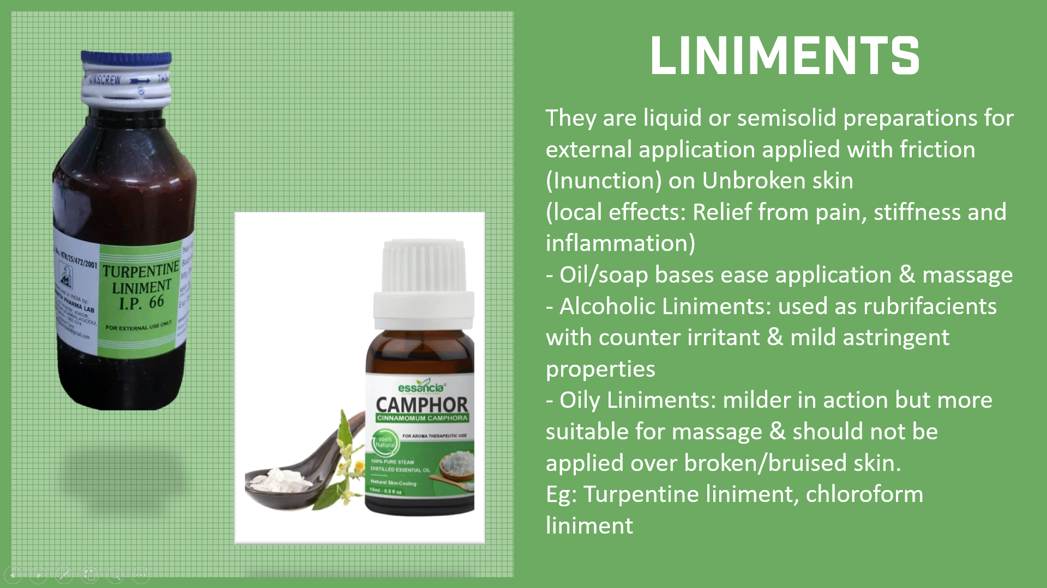
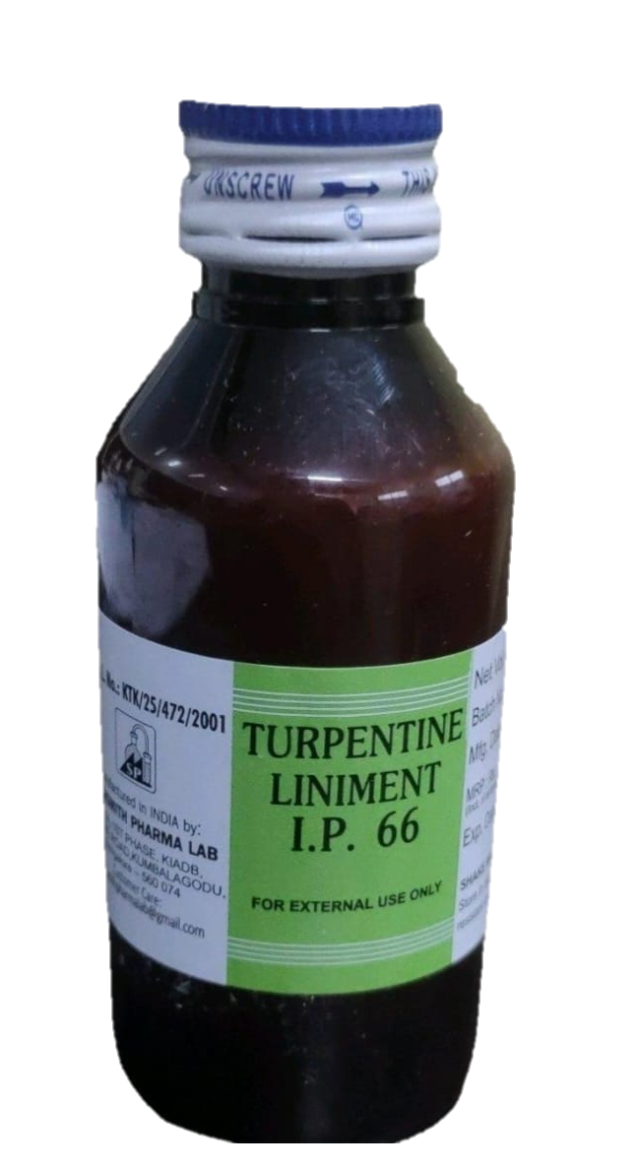
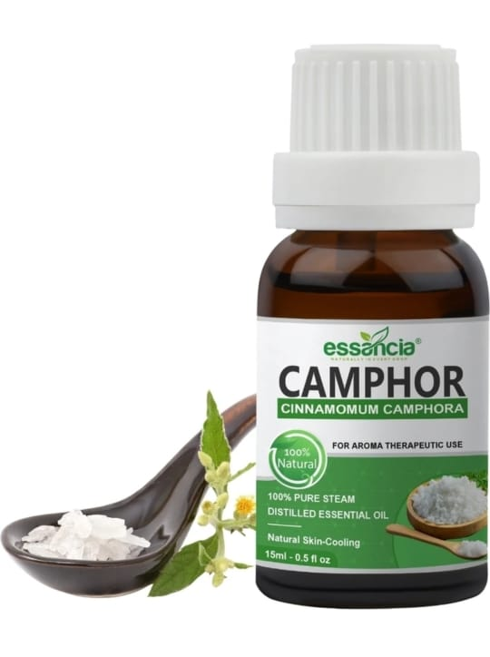
LINIMENTS
They are liquid or semisolid preparations for external application applied with friction (Inunction) on Unbroken skin (local effects: Relief from pain, stiffness and inflammation) - Oil/soap bases ease application & massage
- Alcoholic Liniments: used as rubrifacients with counter irritant & mild astringent properties
- Oily Liniments: milder in action but more suitable for massage & should not be applied over broken/bruised skin.
Eg: Turpentine liniment, chloroform liniment

Slide 5
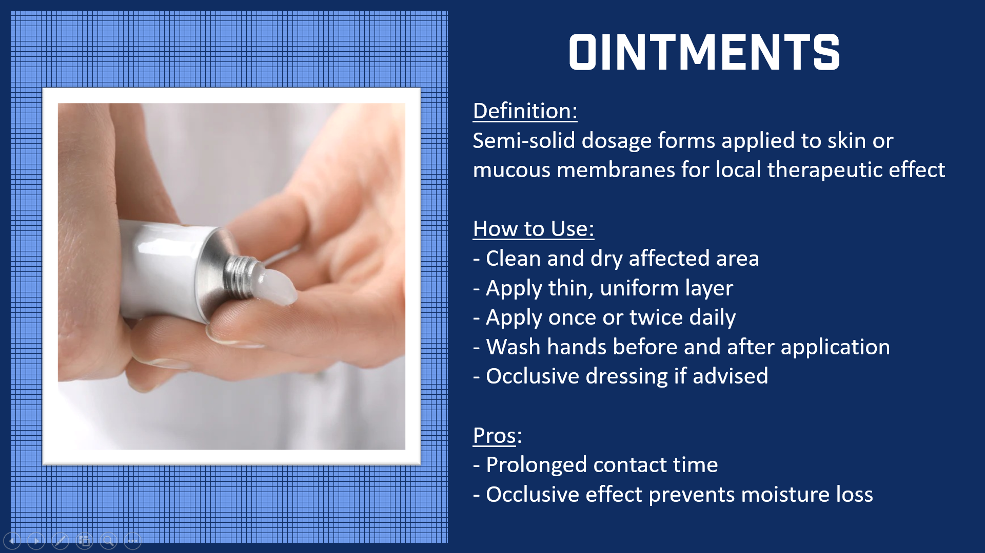
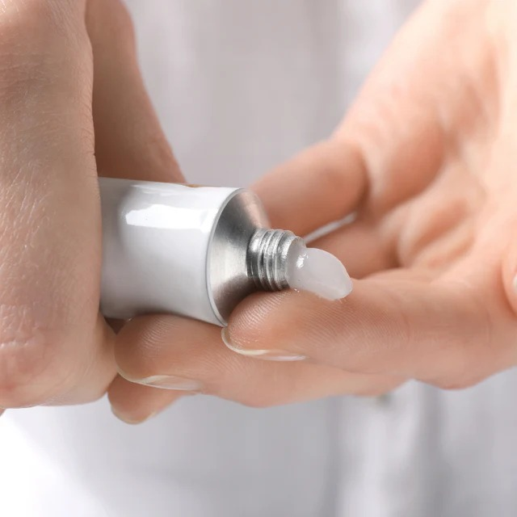
OINTMENTS
Definition:
Semi-solid dosage forms applied to skin or mucous membranes for local therapeutic effect
How to Use:
- Clean and dry affected area
- Apply thin, uniform layer
- Apply once or twice daily
- Wash hands before and after application
- Occlusive dressing if advised
Pros: - Prolonged contact time
- Occlusive effect prevents moisture loss

Slide 6
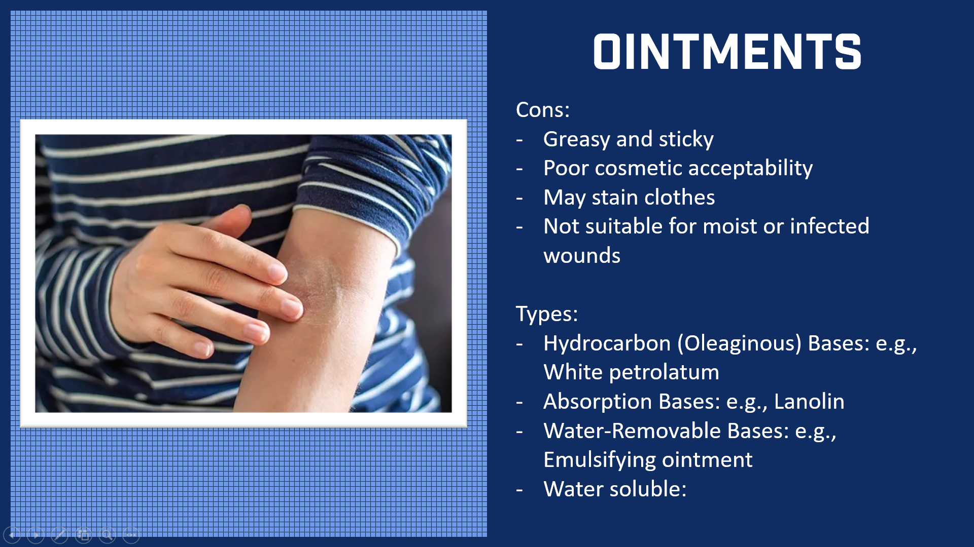
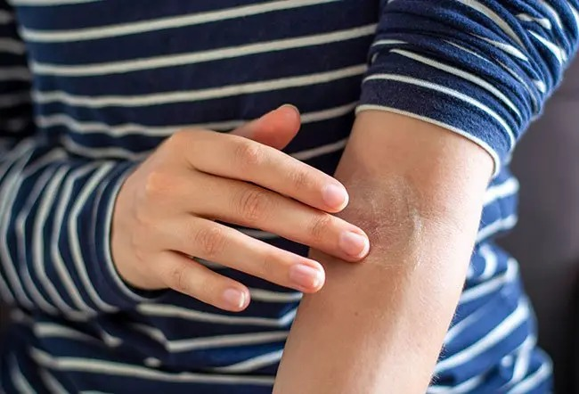
OINTMENTS
Cons:
Greasy and sticky
Poor cosmetic acceptability
May stain clothes
Not suitable for moist or infected wounds
Types:
Hydrocarbon (Oleaginous) Bases: e.g., White petrolatum
Absorption Bases: e.g., Lanolin
Water-Removable Bases: e.g., Emulsifying ointment
Water soluble:

Slide 7
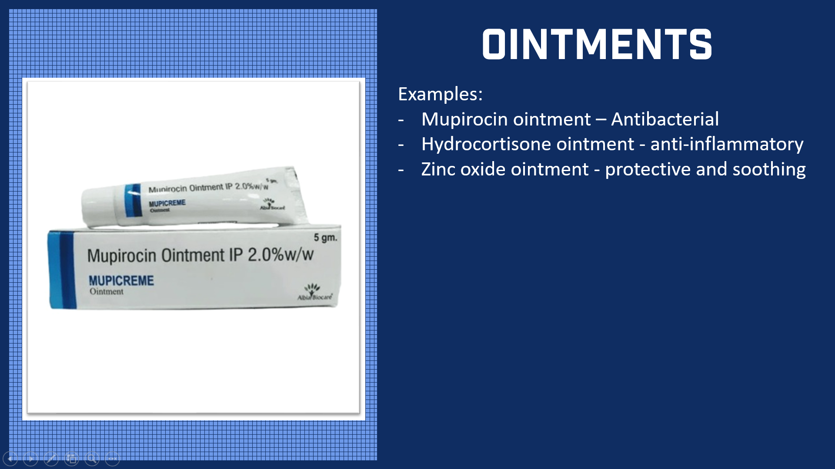
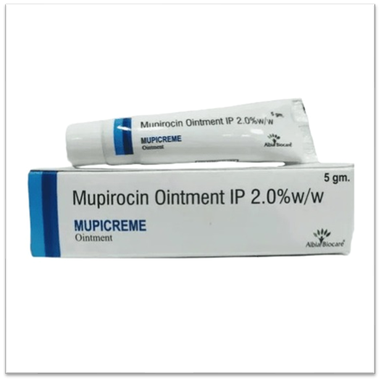
OINTMENTS
Examples:
Mupirocin ointment – Antibacterial
Hydrocortisone ointment - anti-inflammatory
Zinc oxide ointment - protective and soothing

Slide 8
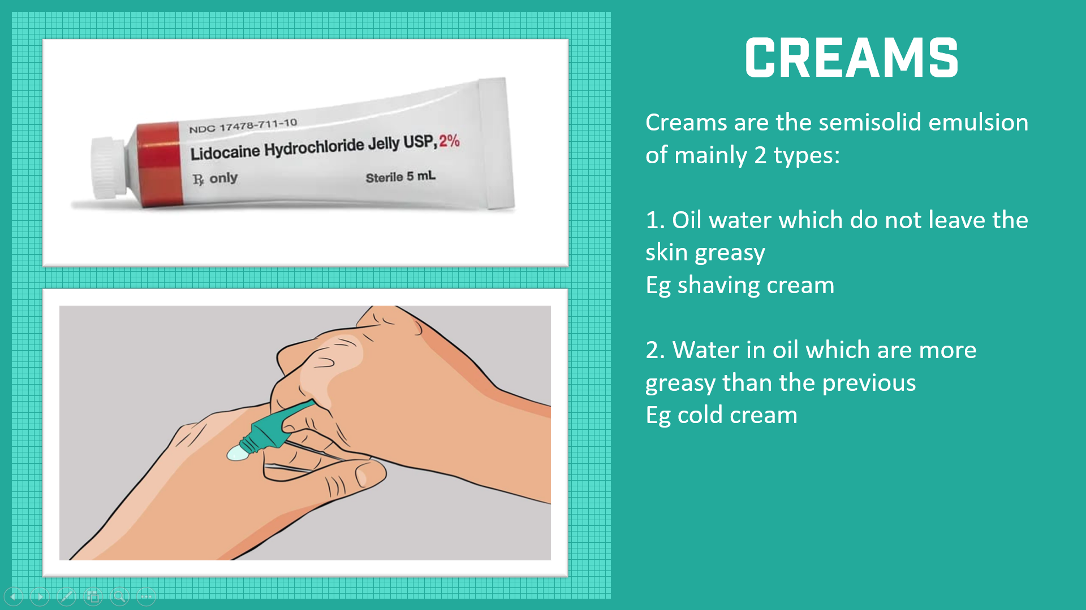
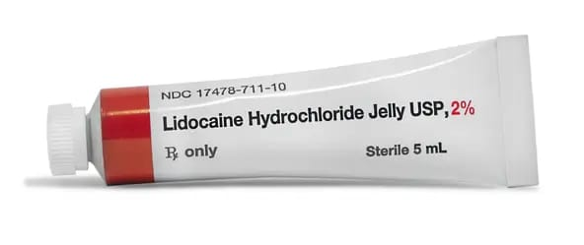
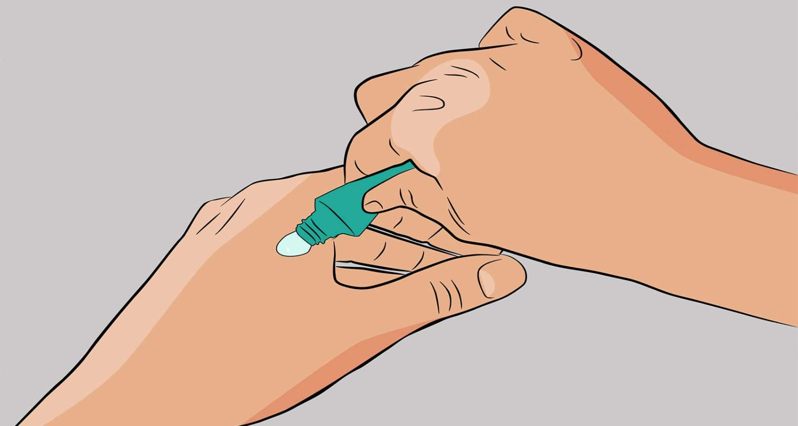
CREAMS
Creams are the semisolid emulsion of mainly 2 types:
1. Oil water which do not leave the skin greasy Eg shaving cream
2. Water in oil which are more greasy than the previous Eg cold cream

Slide 9
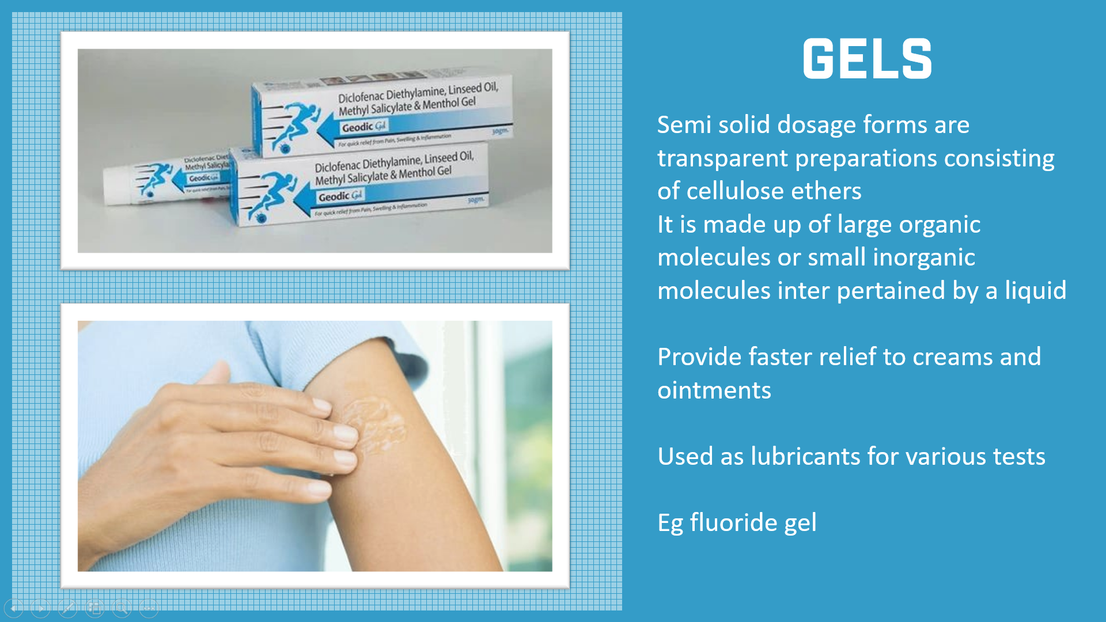
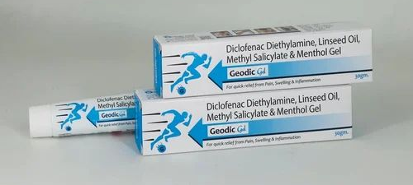
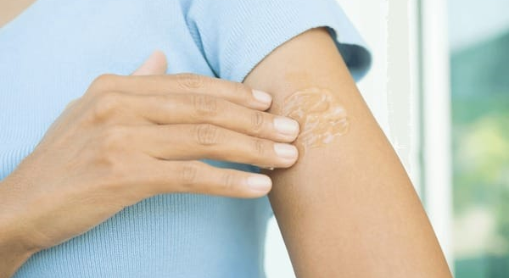
GELS
Semi solid dosage forms are transparent preparations consisting of cellulose ethers
It is made up of large organic molecules or small inorganic molecules inter pertained by a liquid
Provide faster relief to creams and ointments
Used as lubricants for various tests
Eg fluoride gel

Slide 10
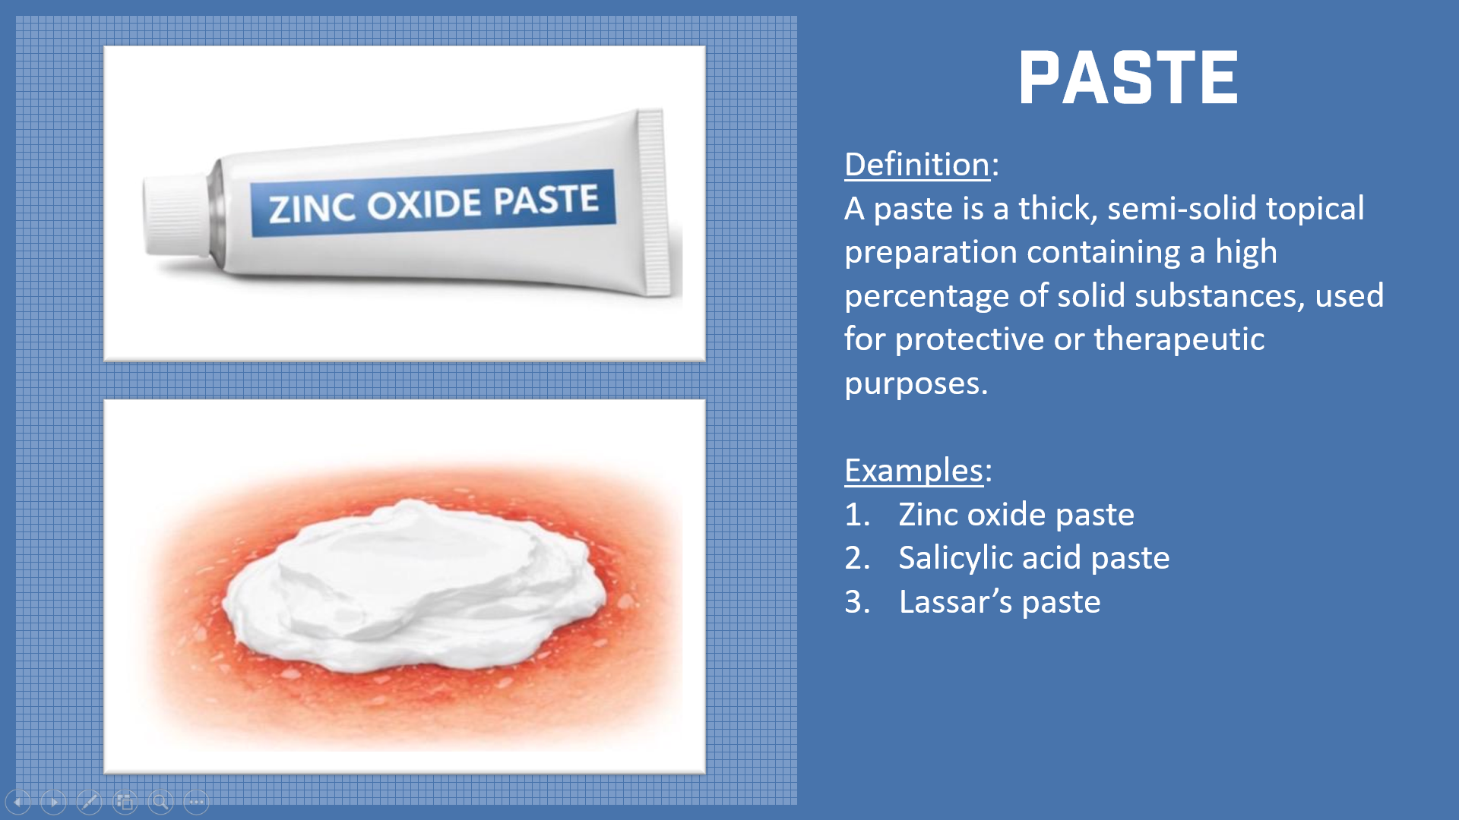
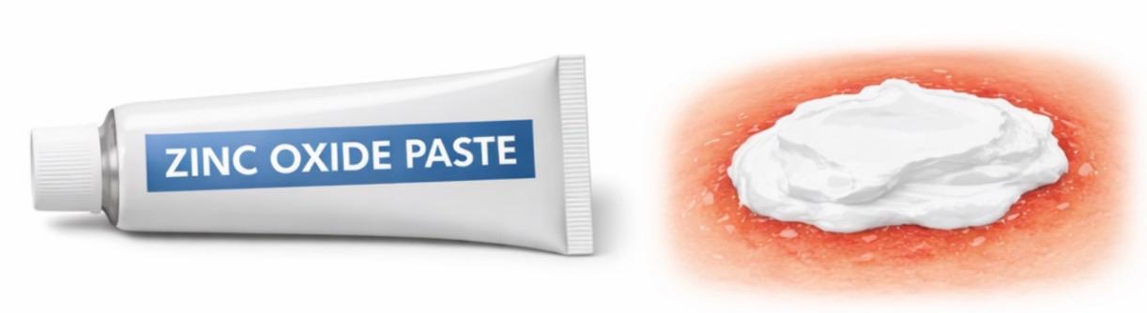
PASTE
Definition:
A paste is a thick, semi-solid topical preparation containing a high percentage of solid substances, used for protective or therapeutic purposes.
Examples:
Zinc oxide paste
Salicylic acid paste
Lassar’s paste

Slide 11
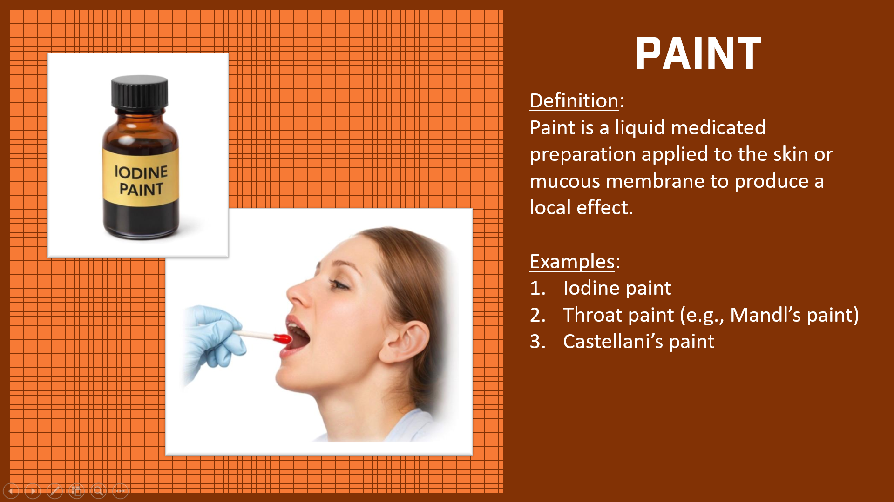
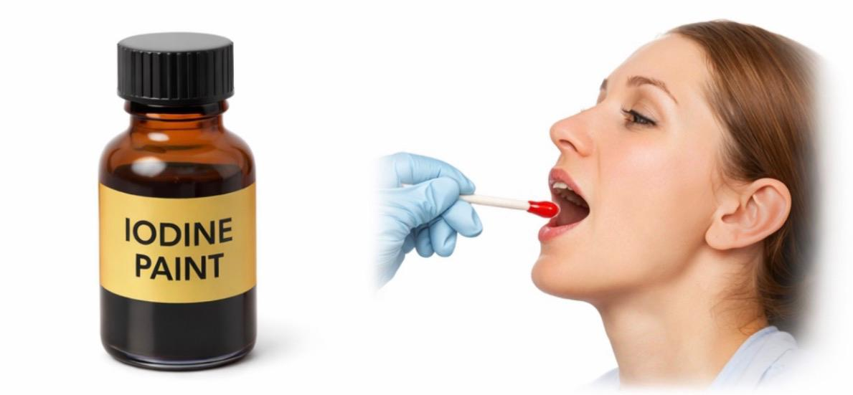
PAINT
Definition:
Paint is a liquid medicated preparation applied to the skin or mucous membrane to produce a local effect.
Examples:
Iodine paint
Throat paint (e.g., Mandl’s paint)
Castellani’s paint

Slide 12
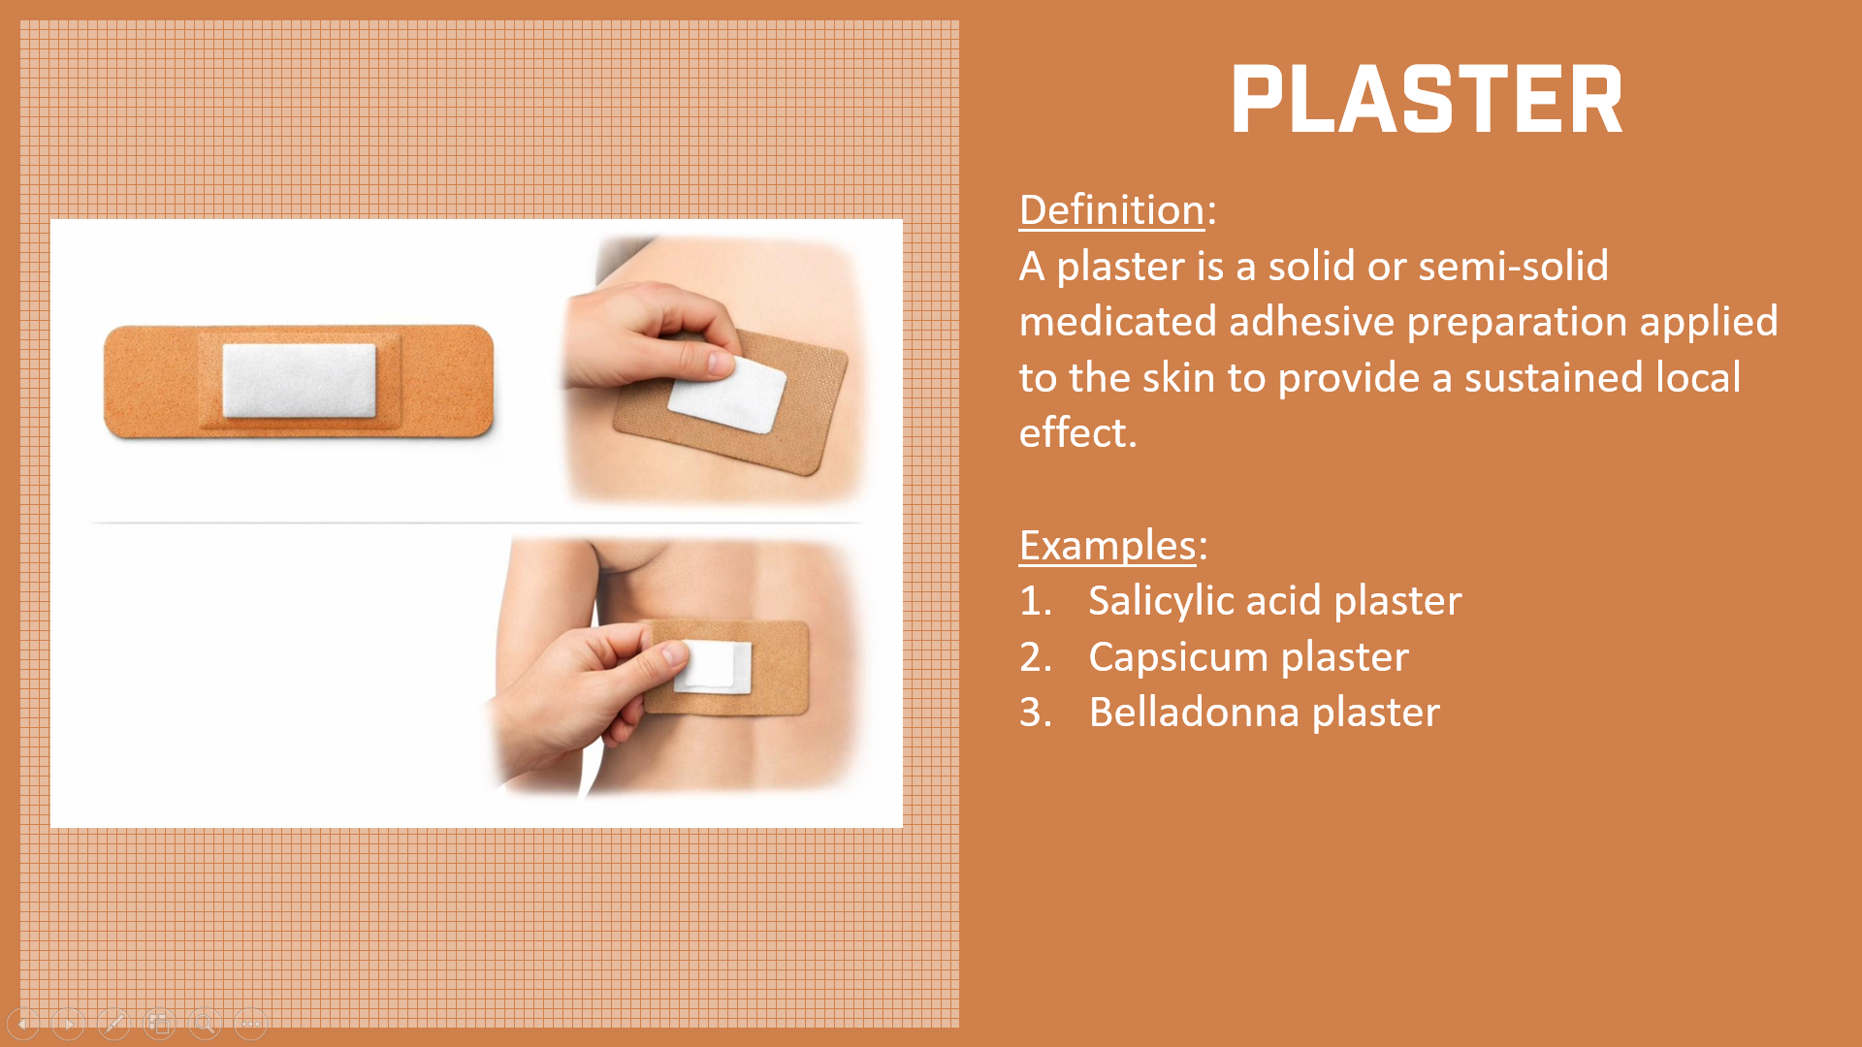
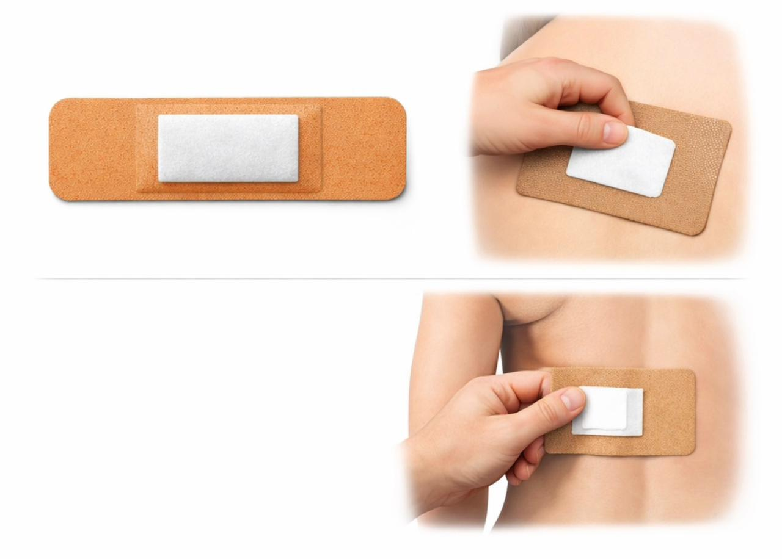
PLASTER
Definition:
A plaster is a solid or semi-solid medicated adhesive preparation applied to the skin to provide a sustained local effect.
Examples:
Salicylic acid plaster
Capsicum plaster
Belladonna plaster

Slide 13
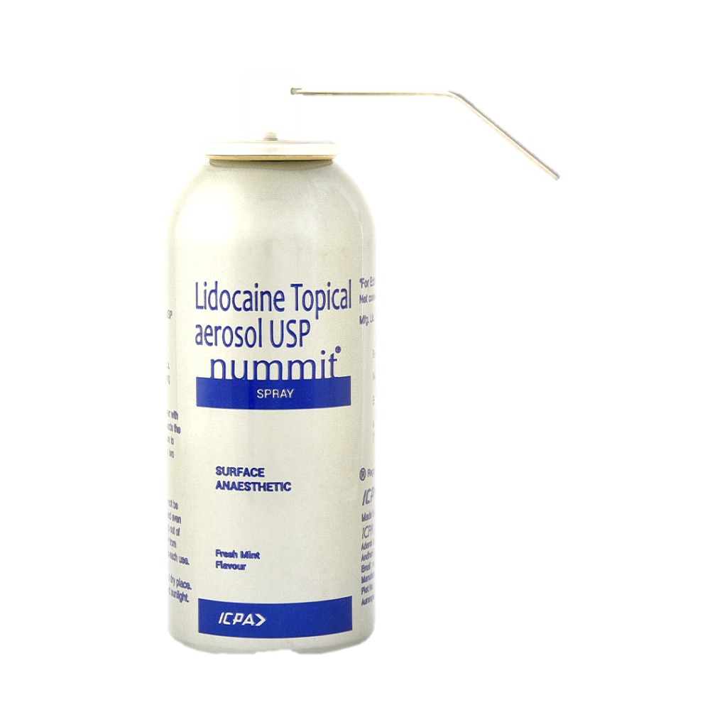
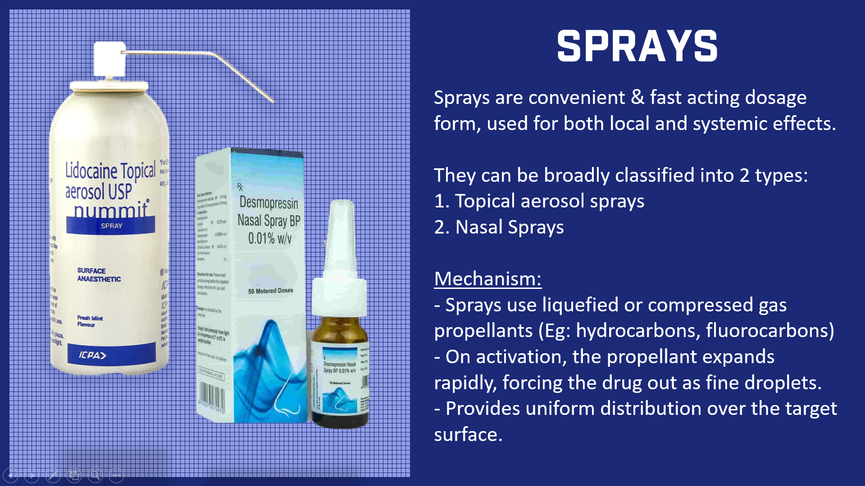
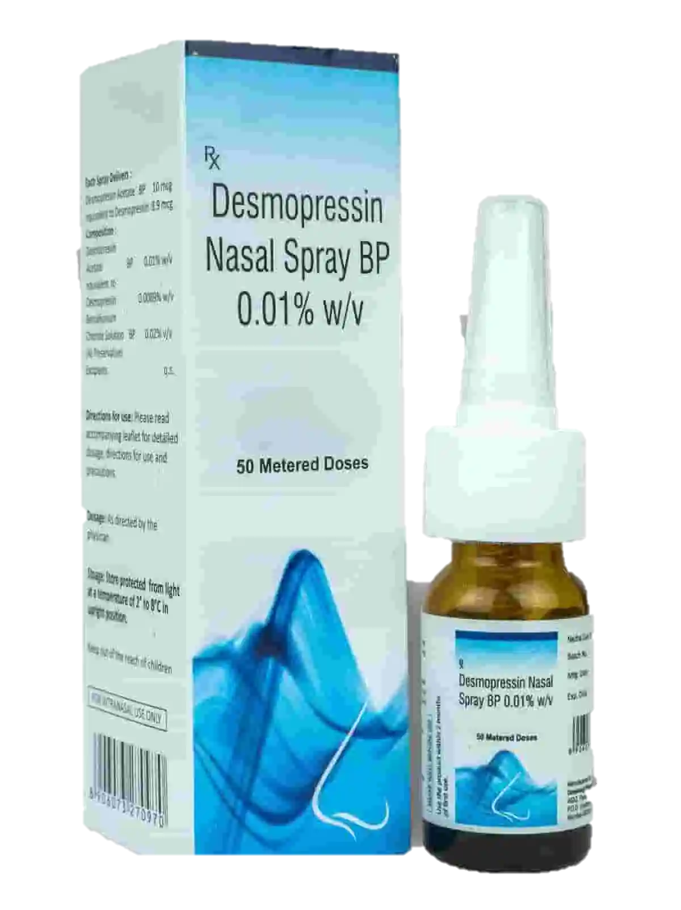
SPRAYS
Sprays are convenient & fast acting dosage form, used for both local and systemic effects.
They can be broadly classified into 2 types:
1. Topical aerosol sprays
2. Nasal Sprays
Mechanism: - Sprays use liquefied or compressed gas propellants (Eg: hydrocarbons, fluorocarbons)
- On activation, the propellant expands rapidly, forcing the drug out as fine droplets.
- Provides uniform distribution over the target surface.

Slide 14
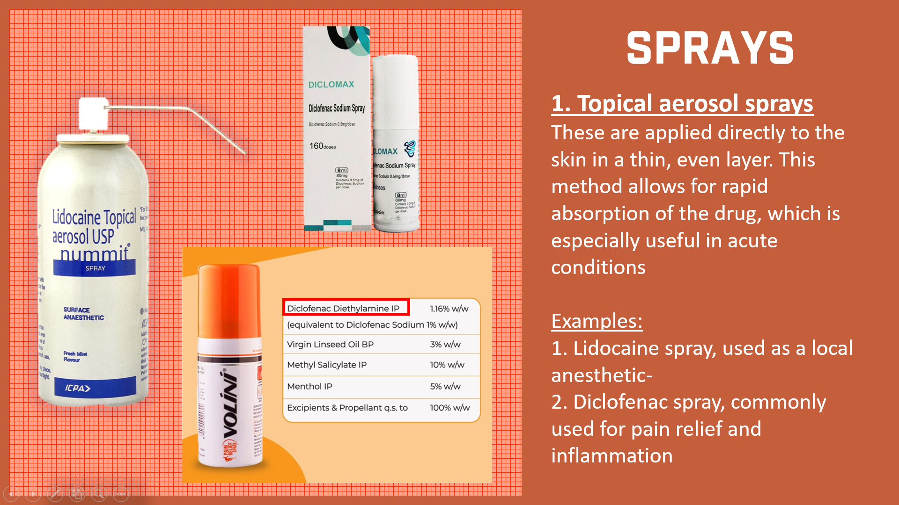
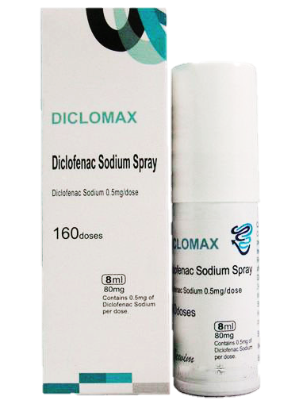
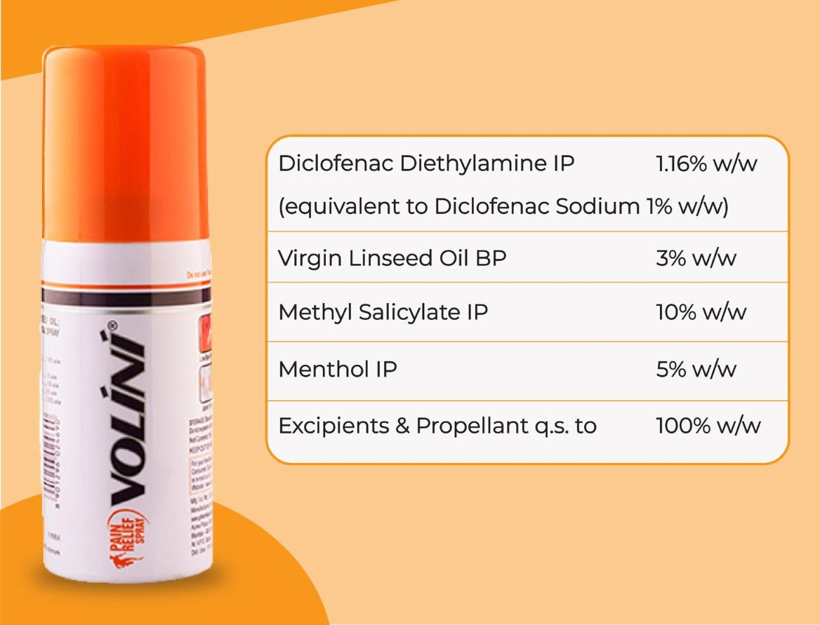
SPRAYS
1. Topical aerosol sprays
These are applied directly to the skin in a thin, even layer. This method allows for rapid absorption of the drug, which is especially useful in acute conditions
Examples: 1. Lidocaine spray, used as a local anesthetic-
2. Diclofenac spray, commonly used for pain relief and inflammation

Slide 15
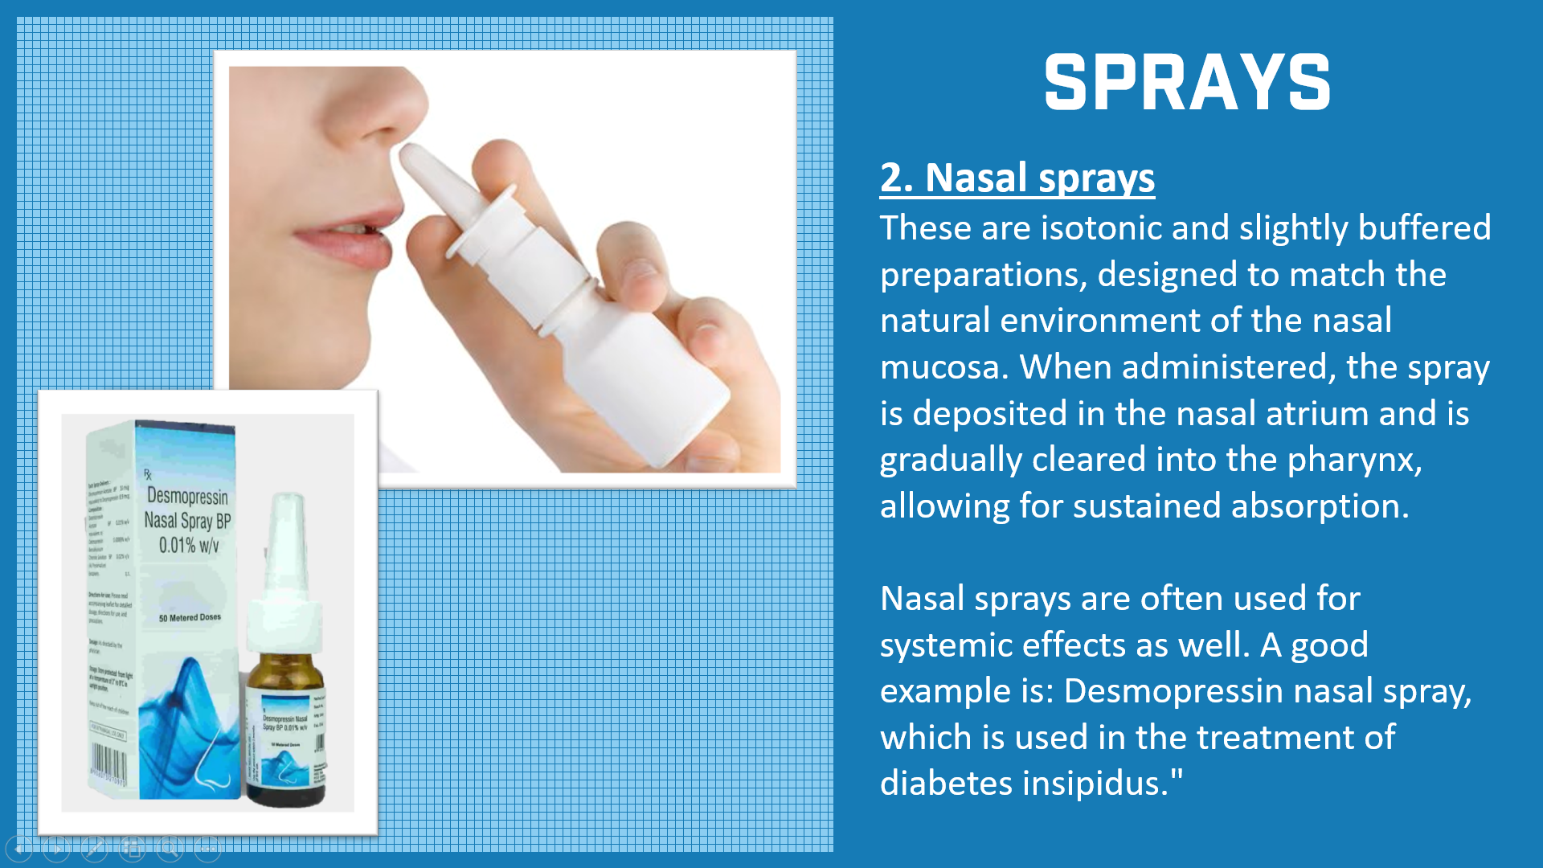
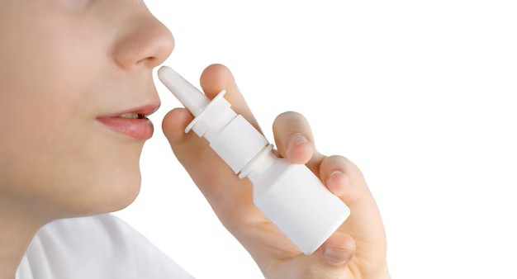
SPRAYS
2. Nasal sprays
These are isotonic and slightly buffered preparations, designed to match the natural environment of the nasal mucosa. When administered, the spray is deposited in the nasal atrium and is gradually cleared into the pharynx, allowing for sustained absorption.
Nasal sprays are often used for systemic effects as well. A good example is: Desmopressin nasal spray, which is used in the treatment of diabetes insipidus."

Slide 16
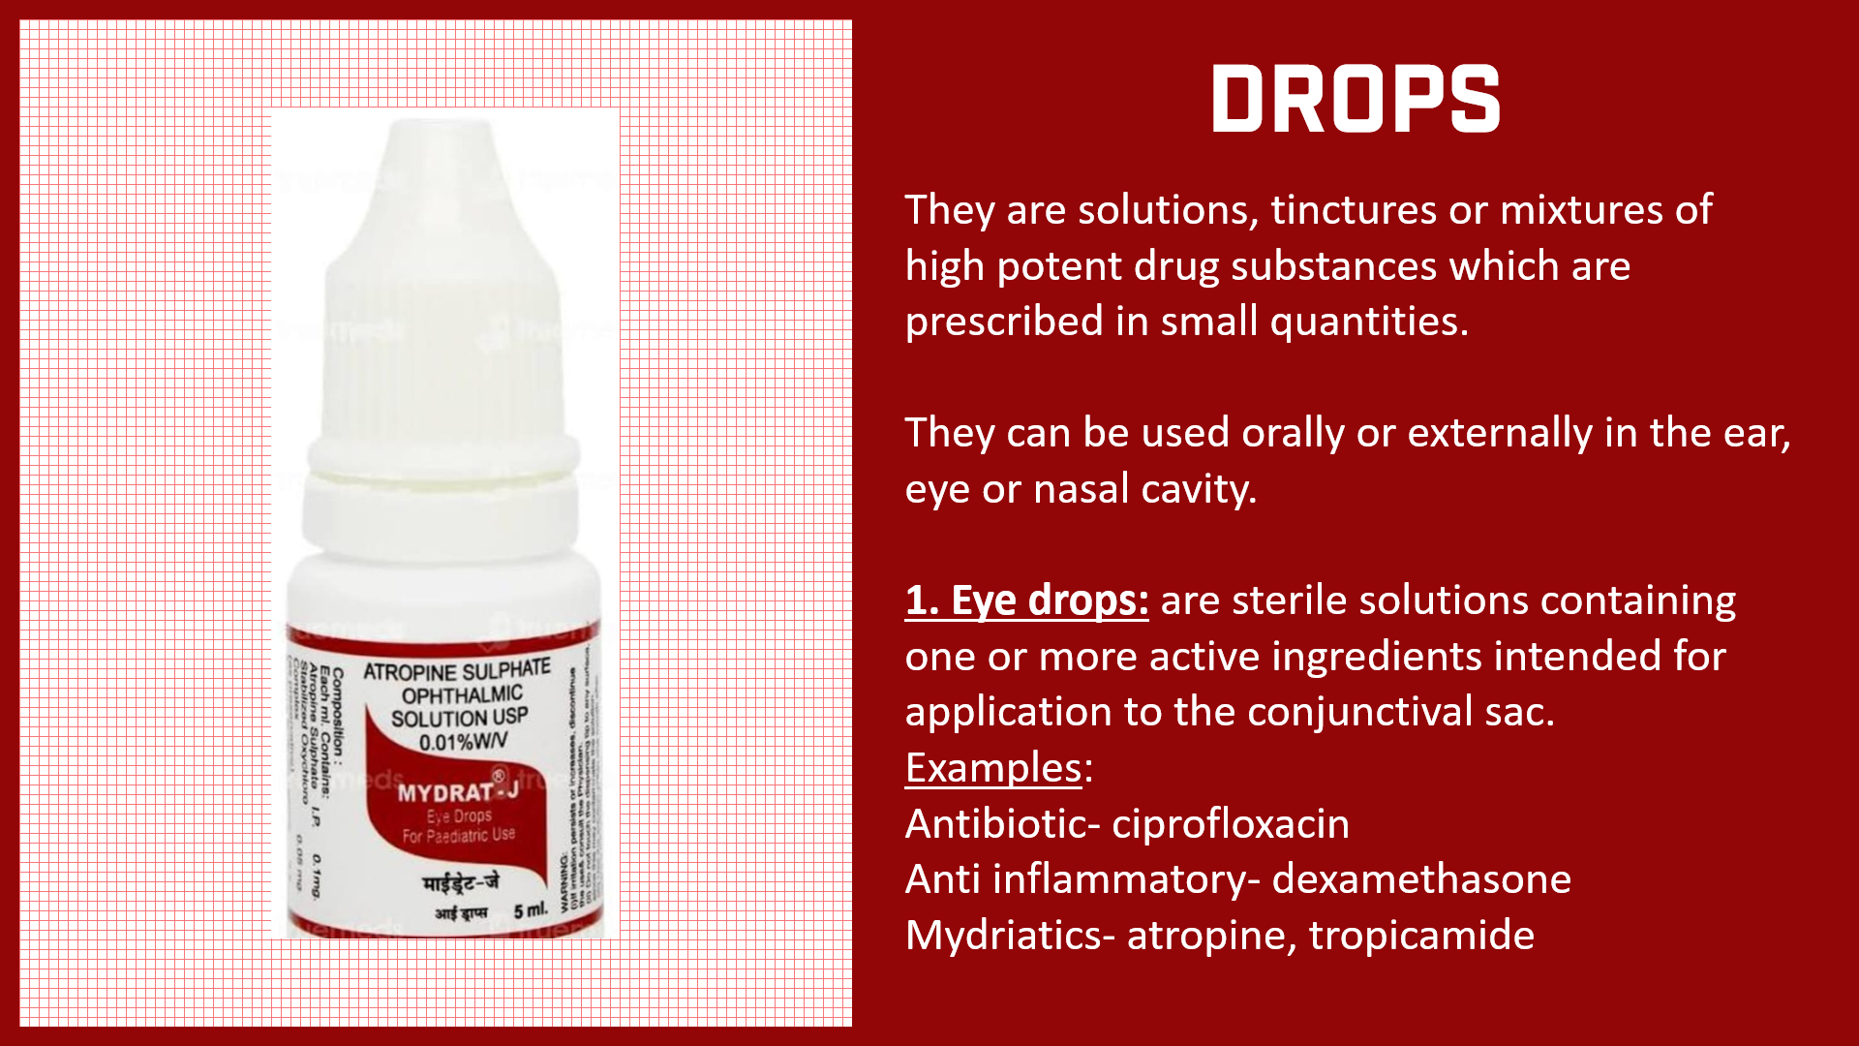
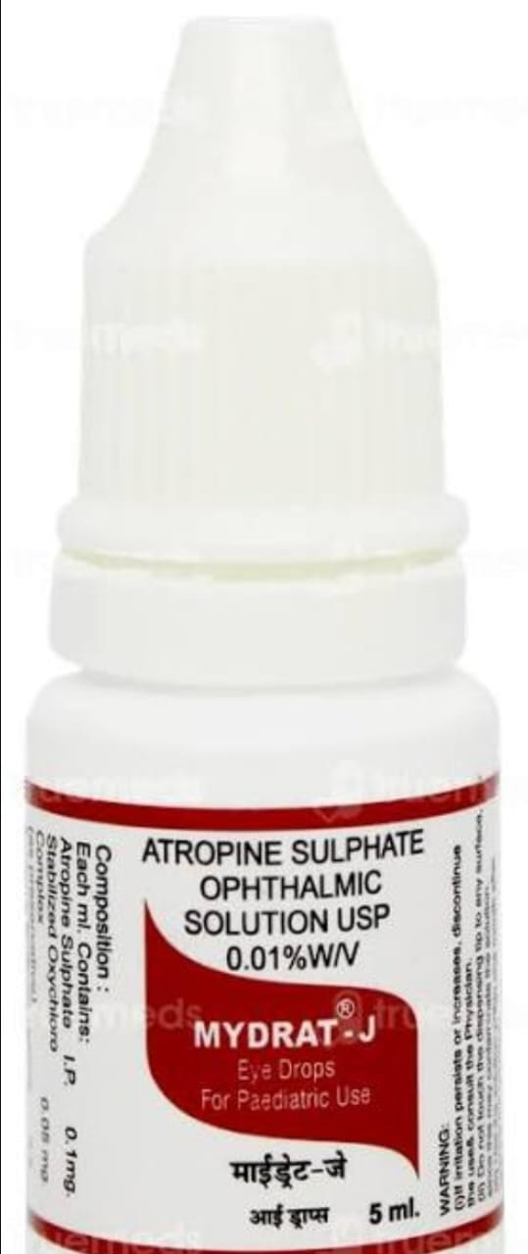
DROPS
They are solutions, tinctures or mixtures of high potent drug substances which are prescribed in small quantities.
They can be used orally or externally in the ear, eye or nasal cavity.
1. Eye drops: are sterile solutions containing one or more active ingredients intended for application to the conjunctival sac.
Examples:
Antibiotic- ciprofloxacin
Anti inflammatory- dexamethasone
Mydriatics- atropine, tropicamide

Slide 17
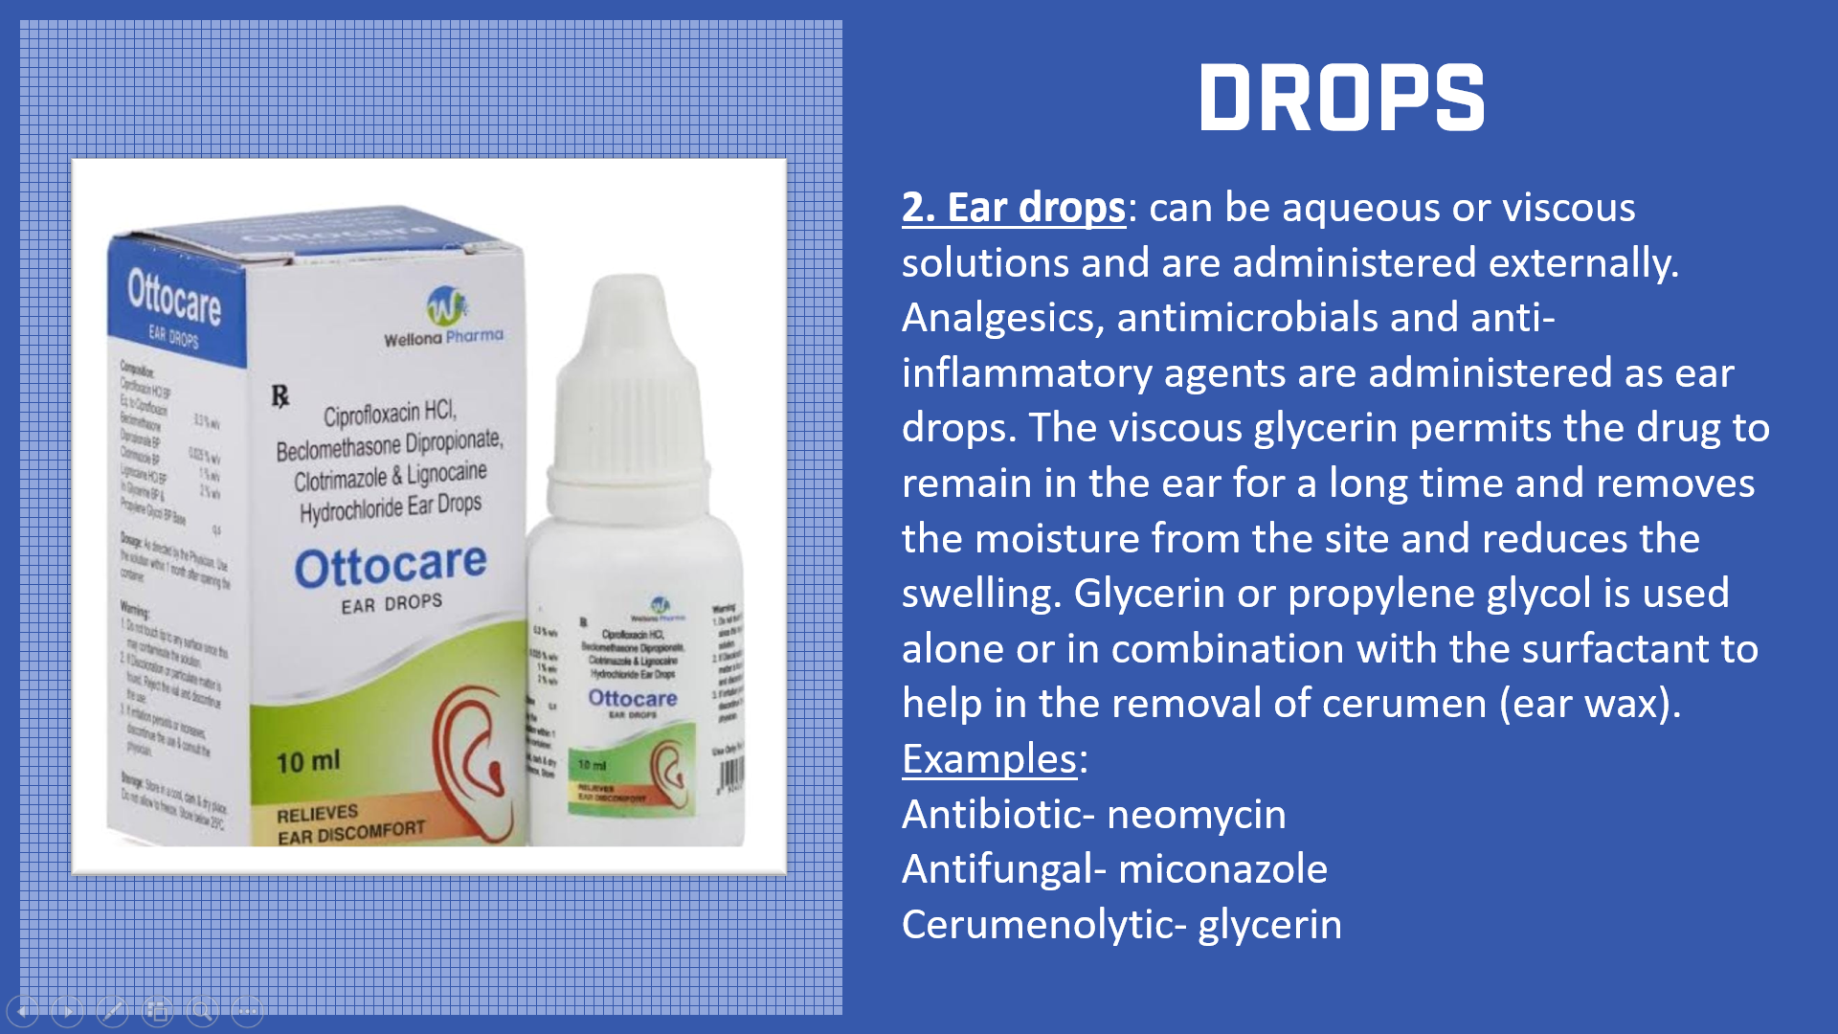
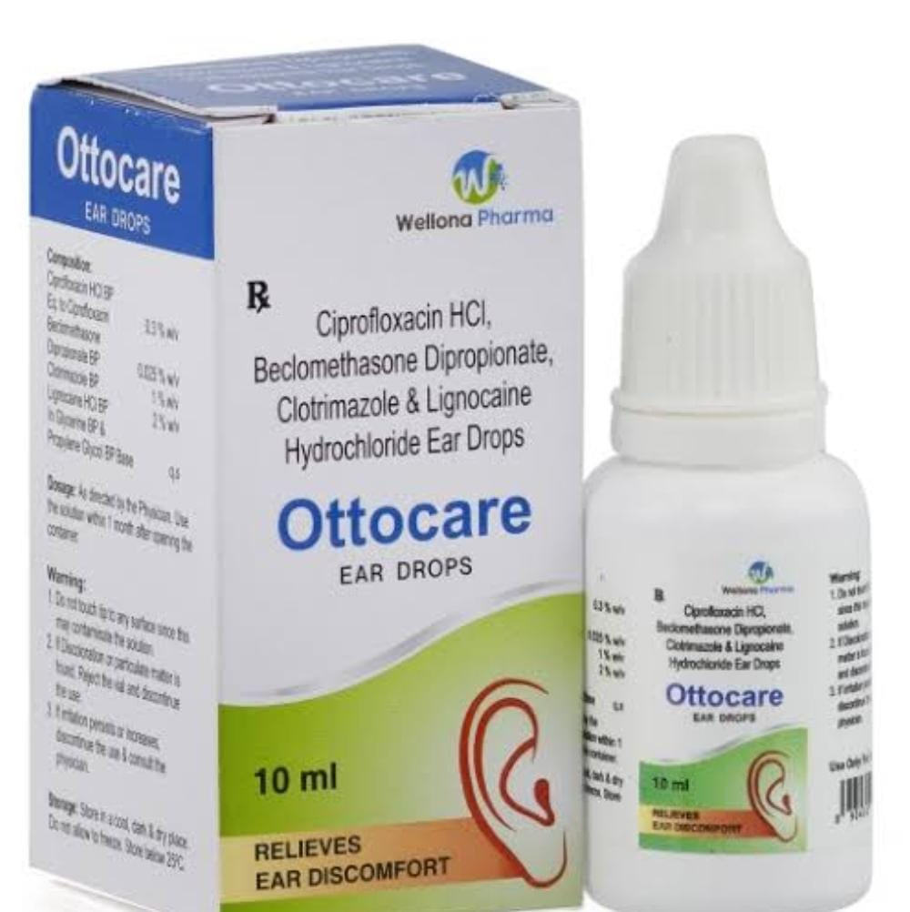
DROPS
2. Ear drops: can be aqueous or viscous solutions and are administered externally. Analgesics, antimicrobials and anti-inflammatory agents are administered as ear drops. The viscous glycerin permits the drug to remain in the ear for a long time and removes the moisture from the site and reduces the swelling. Glycerin or propylene glycol is used alone or in combination with the surfactant to help in the removal of cerumen (ear wax).
Examples: Antibiotic- neomycin
Antifungal- miconazole
Cerumenolytic- glycerin

Slide 18
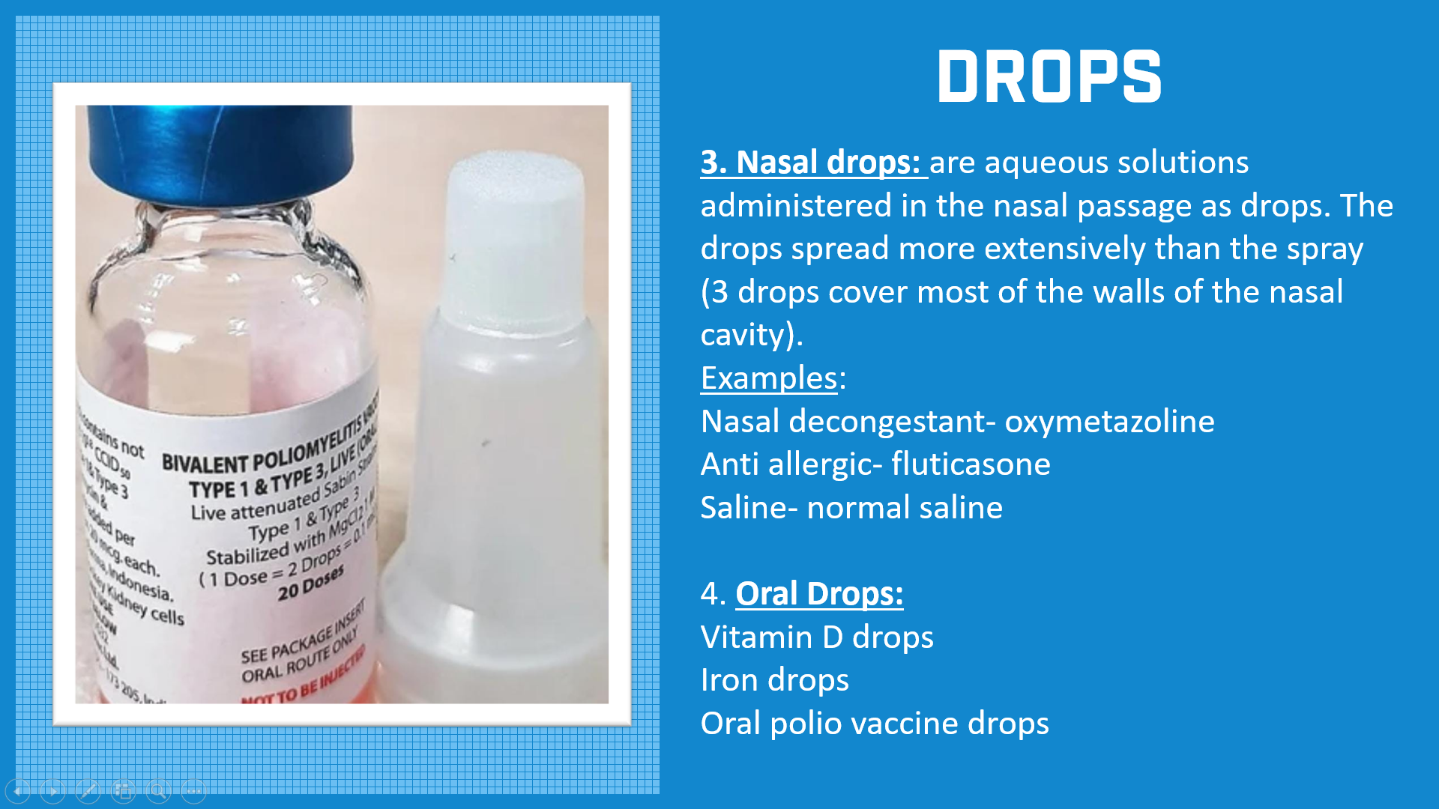
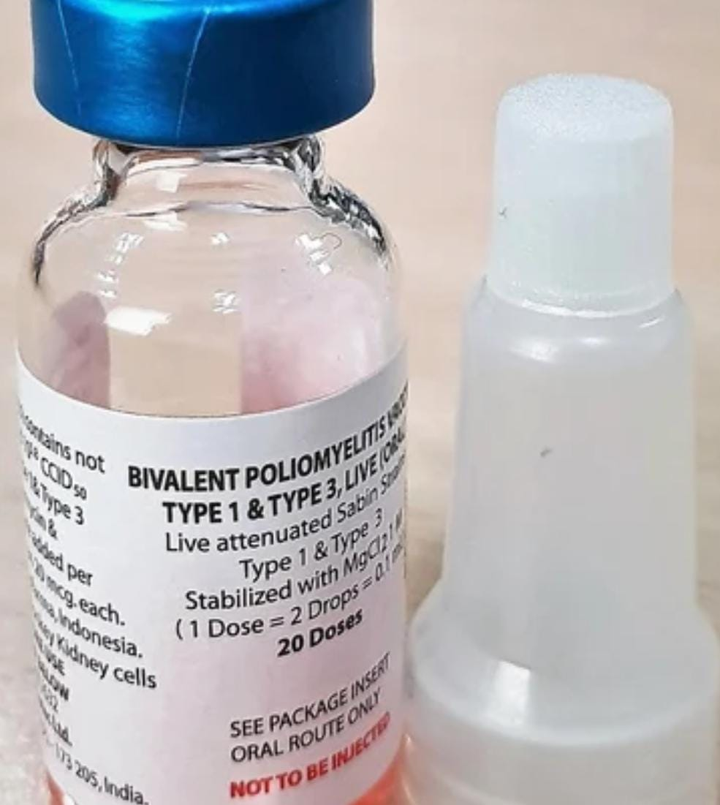
DROPS
3. Nasal drops: are aqueous solutions administered in the nasal passage as drops. The drops spread more extensively than the spray (3 drops cover most of the walls of the nasal cavity).
Examples: Nasal decongestant- oxymetazoline
Anti allergic- fluticasone
Saline- normal saline
4. Oral Drops:
Vitamin D drops
Iron drops
Oral polio vaccine drops

Slide 19
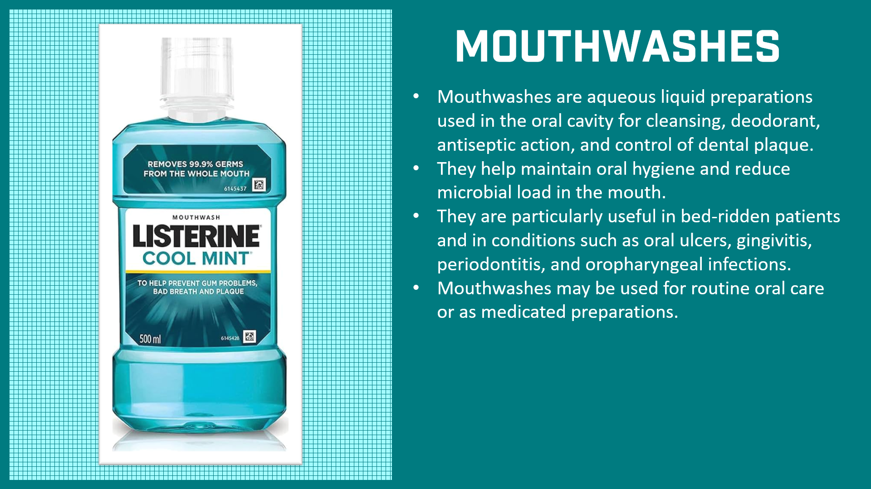
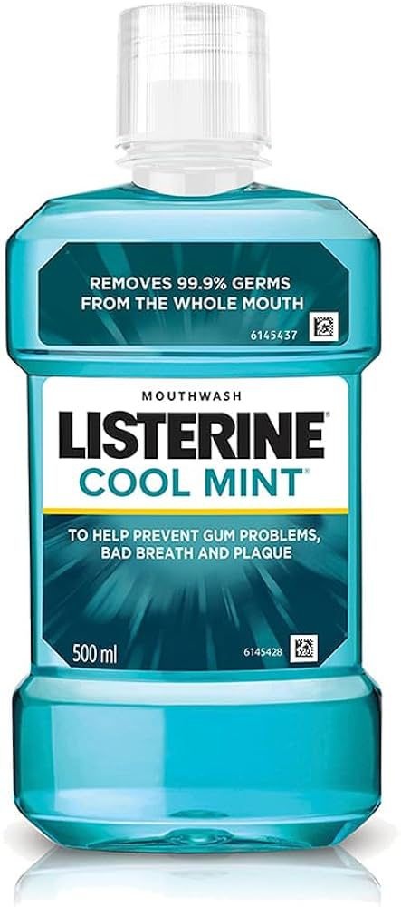
MOUTHWASHES
Mouthwashes are aqueous liquid preparations used in the oral cavity for cleansing, deodorant, antiseptic action, and control of dental plaque.
They help maintain oral hygiene and reduce microbial load in the mouth.
They are particularly useful in bed-ridden patients and in conditions such as oral ulcers, gingivitis, periodontitis, and oropharyngeal infections.
Mouthwashes may be used for routine oral care or as medicated preparations.

Slide 20
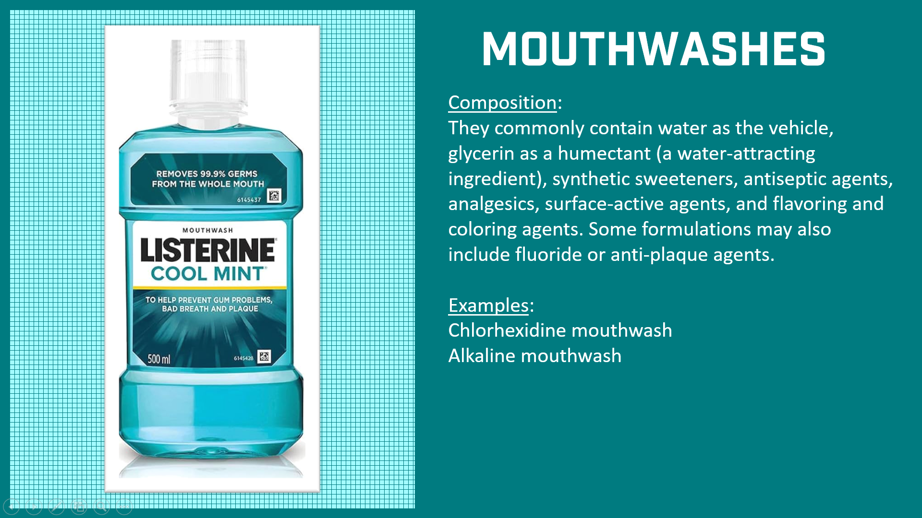
MOUTHWASHES
Composition:
They commonly contain water as the vehicle, glycerin as a humectant (a water-attracting ingredient), synthetic sweeteners, antiseptic agents, analgesics, surface-active agents, and flavoring and coloring agents. Some formulations may also include fluoride or anti-plaque agents.
Examples:
Chlorhexidine mouthwash
Alkaline mouthwash

Slide 21
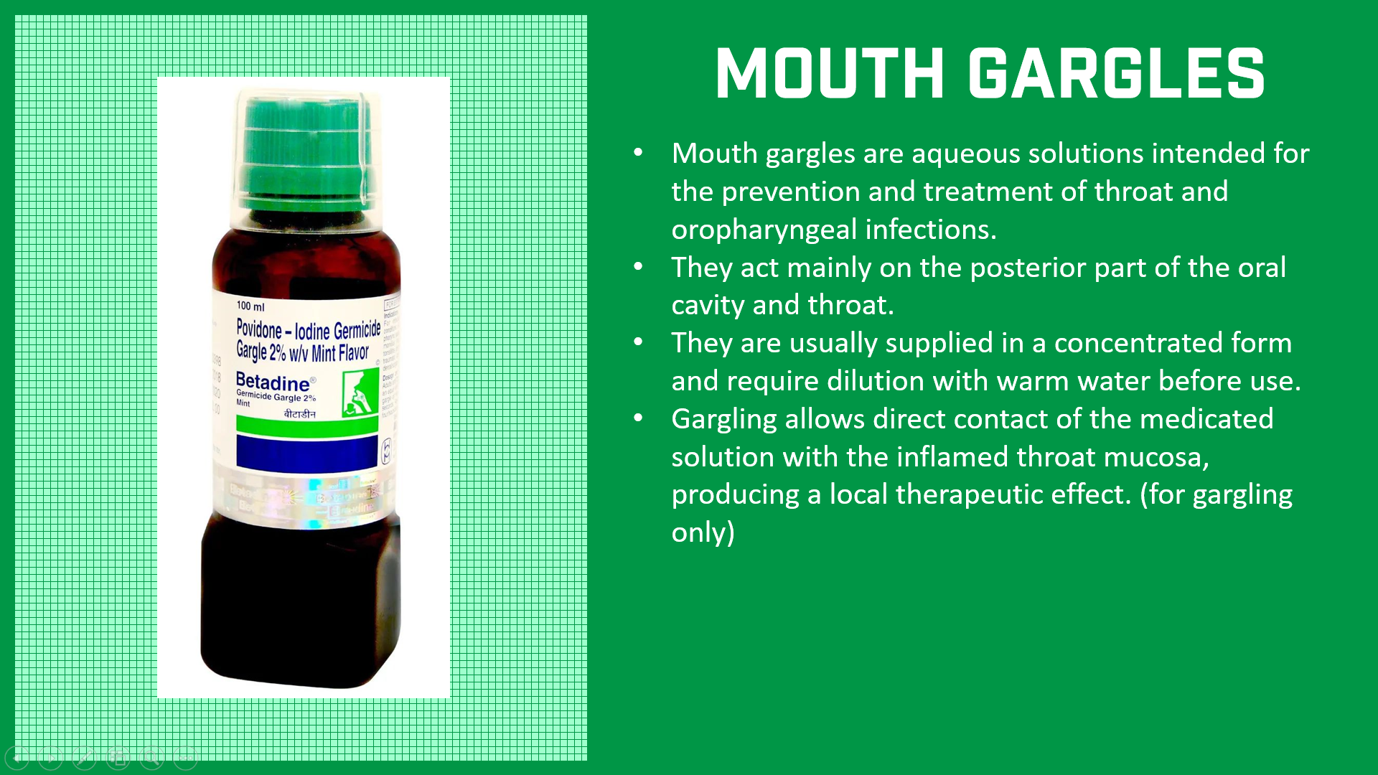
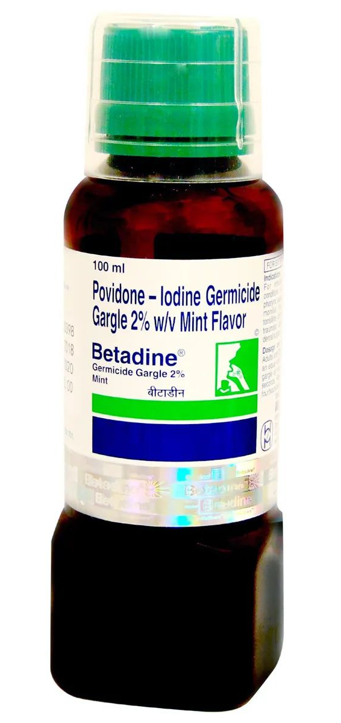
MOUTH GARGLES
Mouth gargles are aqueous solutions intended for the prevention and treatment of throat and oropharyngeal infections.
They act mainly on the posterior part of the oral cavity and throat.
They are usually supplied in a concentrated form and require dilution with warm water before use.
Gargling allows direct contact of the medicated solution with the inflamed throat mucosa, producing a local therapeutic effect. (for gargling only)

Slide 22
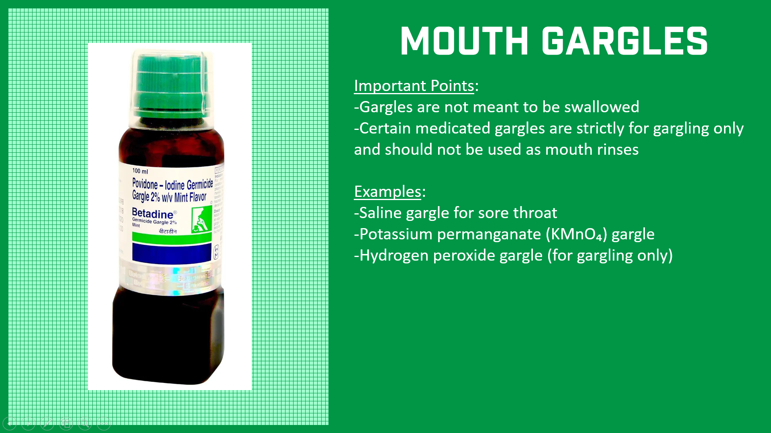
MOUTH GARGLES
Important Points:
-Gargles are not meant to be swallowed
-Certain medicated gargles are strictly for gargling only and should not be used as mouth rinses
Examples:
-Saline gargle for sore throat
-Potassium permanganate (KMnO₄) gargle
-Hydrogen peroxide gargle (for gargling only)

Slide 23
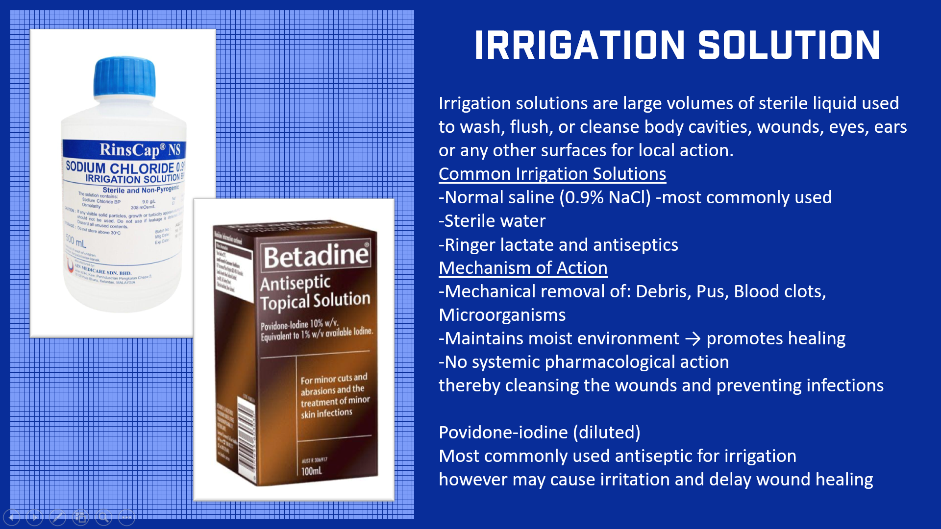
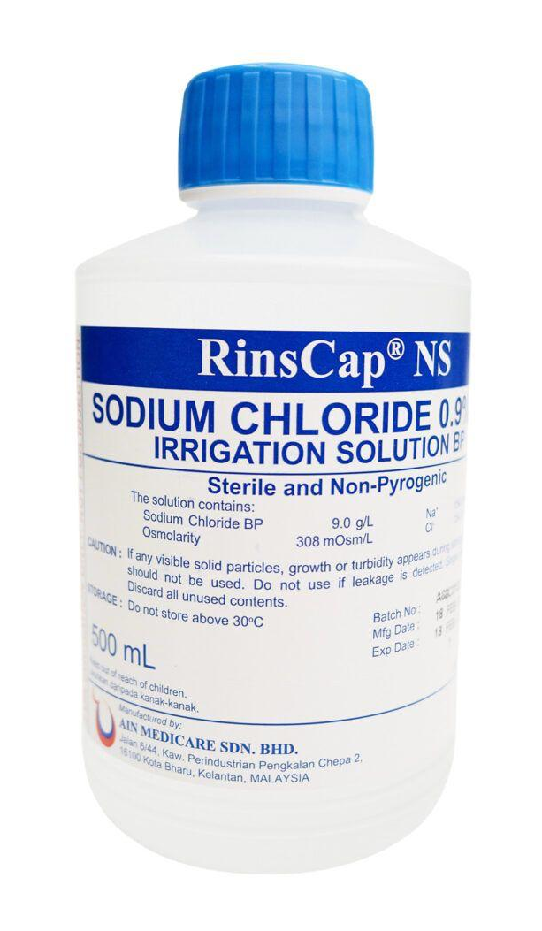
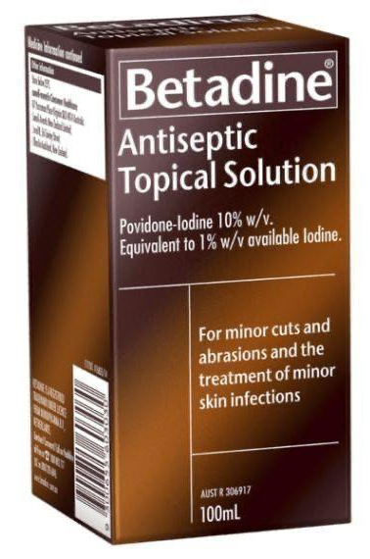
IRRIGATION SOLUTION
Irrigation solutions are large volumes of sterile liquid used to wash, flush, or cleanse body cavities, wounds, eyes, ears or any other surfaces for local action.
Common Irrigation Solutions
-Normal saline (0.9% NaCl) -most commonly used
-Sterile water
-Ringer lactate and antiseptics
Mechanism of Action
-Mechanical removal of: Debris, Pus, Blood clots, Microorganisms
-Maintains moist environment → promotes healing
-No systemic pharmacological action
thereby cleansing the wounds and preventing infections
Povidone-iodine (diluted)
Most commonly used antiseptic for irrigation
however may cause irritation and delay wound healing

Slide 24


DOUCHE
A douche is a liquid preparation used to cleanse the vaginal cavity for local therapeutic or hygienic purposes.
Common Types of Vaginal Douches
-Normal saline
-Dilute antiseptic solutions
-Acidic solutions (rare, outdated)
These help in removal of debris, discharge, microbes etc mainly before gynecological procedures without any systemic absorption
Disadvantages / Risks
-Alters normal vaginal flora
-Can increase risk of PIDs and Vaginal infections
Routine use NOT recommended and is discouraged

Slide 25




ENEMA
They are liquid preparation meant for rectal administration.
There are two types –
Evacuation enema meant for evacuation of the bowel Eg. Soap water enema
Retention enema for producing loc delivery, dec systemic action Eg. Docussates enema

Slide 26



SUPPOSITORIES
A suppository is a form of medication that is a small, solid, round or cone-shaped object designed to be inserted into a body cavity, most commonly the rectum or vagina.
Working: Once inside, body heat causes the suppository's base (such as cocoa butter or gelatin) to melt or dissolve, releasing the medicine for local or systemic absorption.
Types:- Suppositories are used in three main body cavities: 1) Rectal Suppositories These are the most common type and are used for a variety of conditions, including constipation (using laxatives like glycerin), pain and fever relief (e.g., paracetamol)

Slide 27


SUPPOSITORIES
2) Vaginal Suppositories These are typically used to treat local issues like bacterial vaginosis, yeast infections (e.g: Clindamycin vaginal cream) or hormonal imbalances with medications like estrogen or progesterone.
3) Urethral Suppositories These are less common and typically used in men to treat erectile dysfunction with medication such as alprostadil. Uses:- Suppositories are recommended in case of Dysphagia, nausea and vomiting, Faster action, treating local conditions like Hemorrhoids etc.

Slide 28

Group Members:
129 Navneeth
134 Neha Yadav
139 Nireeksha
144 Kaushik
149 Pooja
154 Rachana S
159 Riya Ramesh
164 S N Akash Gupta
169 Sai Karthik
174 Samarth R
179 Saniya Rafeeq
THANK YOU!
Slide Design: Navneeth V ■ Images and Content contributed by all Group members

